Slide 1
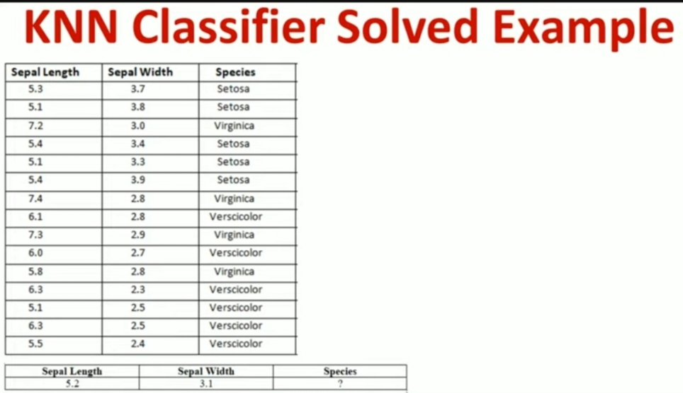
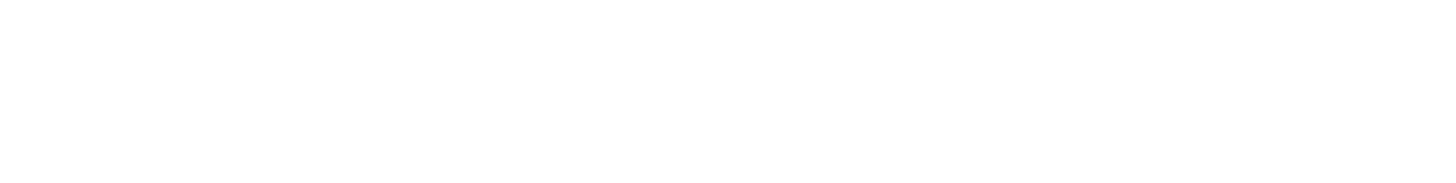

Slide 2
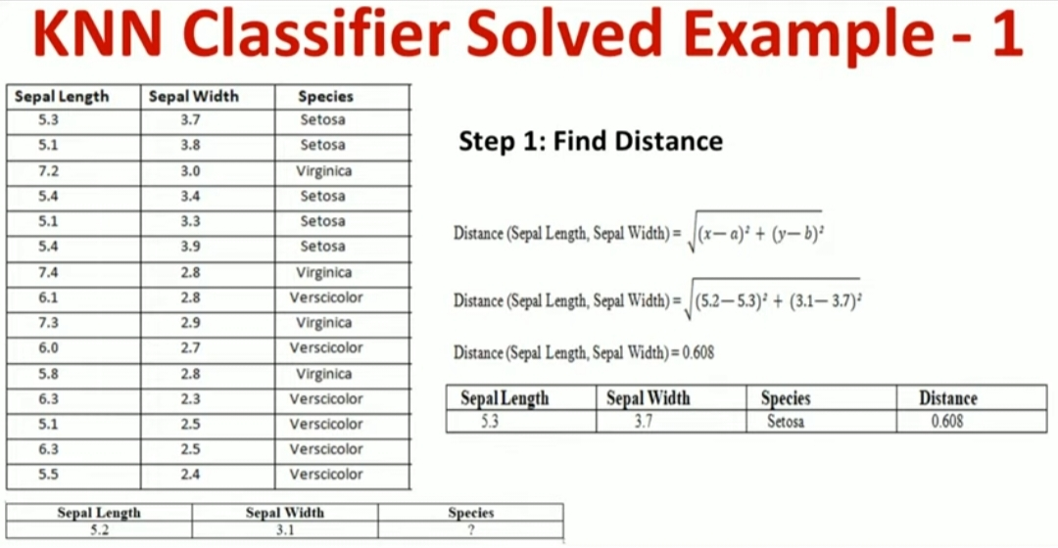

Slide 3
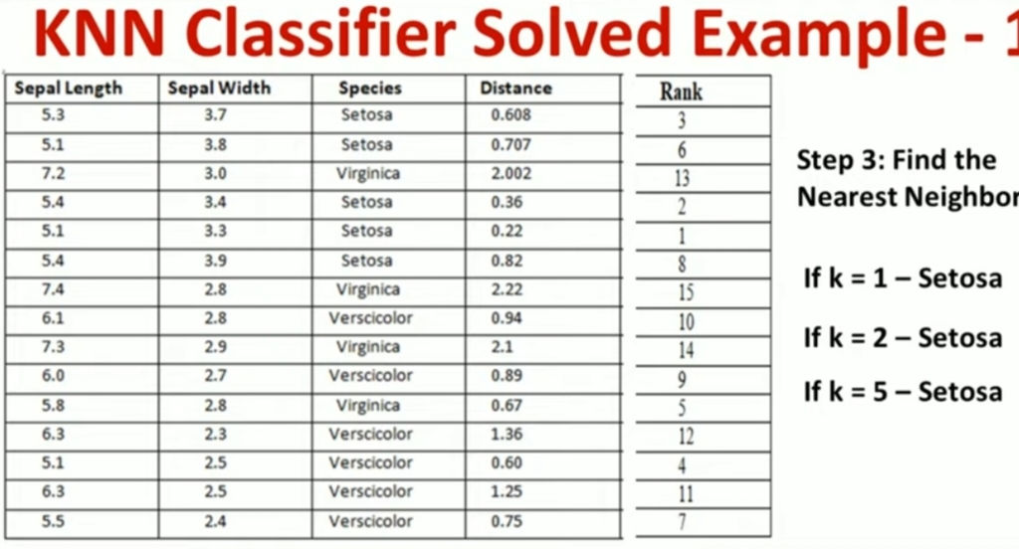

Slide 4
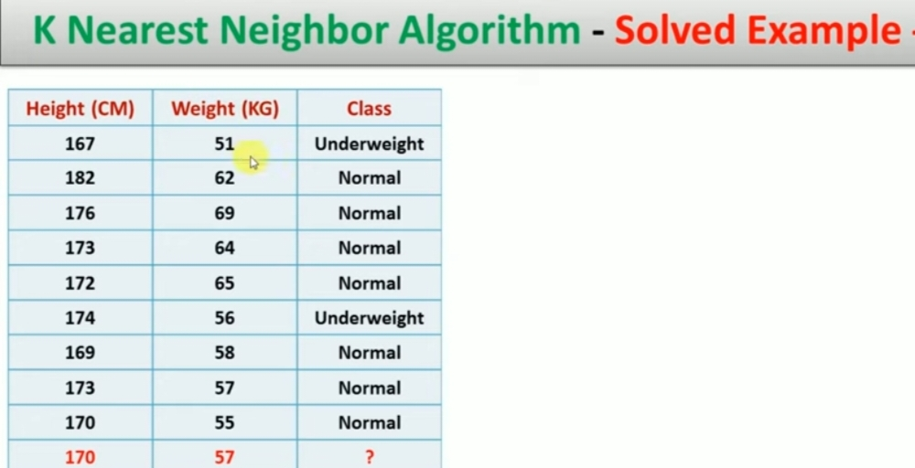

Slide 5
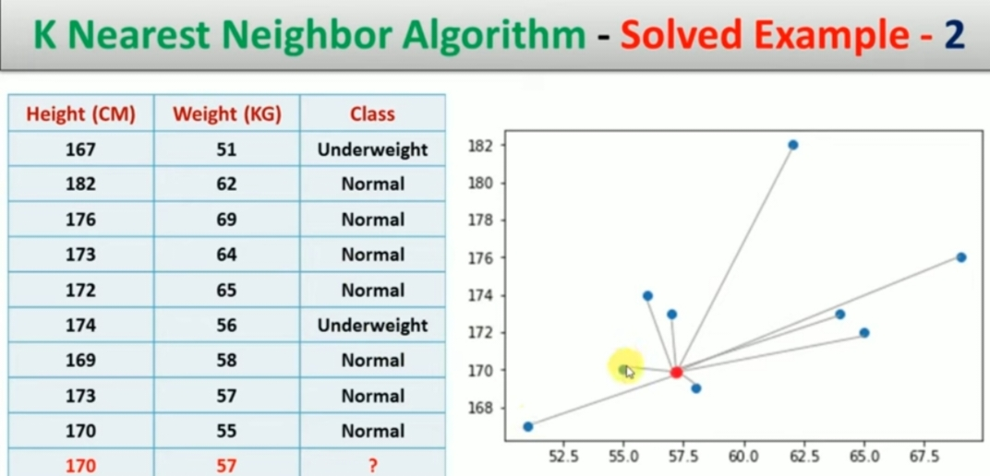

Slide 6
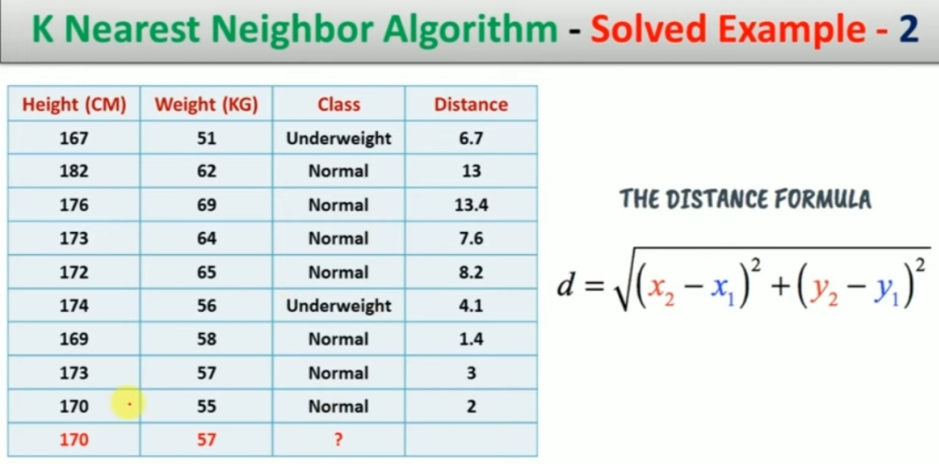

Slide 7
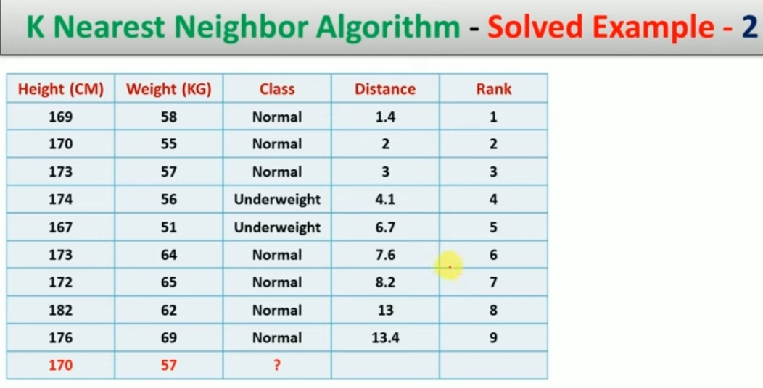

Slide 8
Person | Age | Salary k | Target | Euclidean Distance
A | 18 | 50 | N
B | 23 | 55 | N
C | 24 | 70 | N
D | 41 | 60 | Y
E | 43 | 70 | Y
F | 38 | 40 | Y
X | 35 | 100

Slide 9
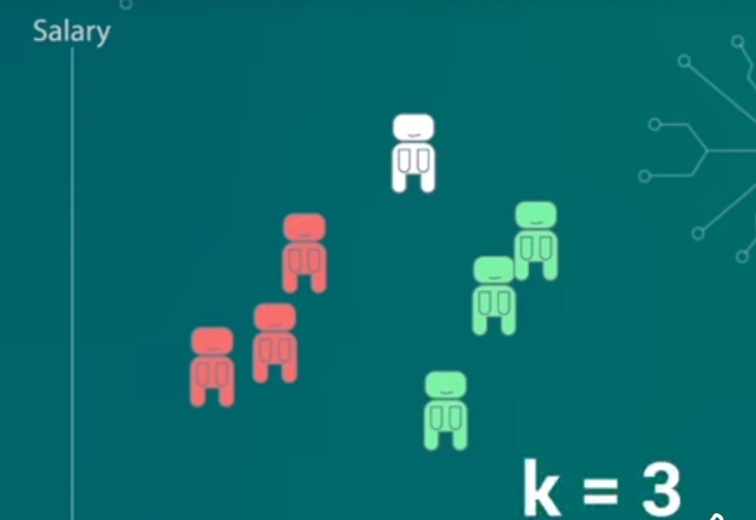

Slide 10
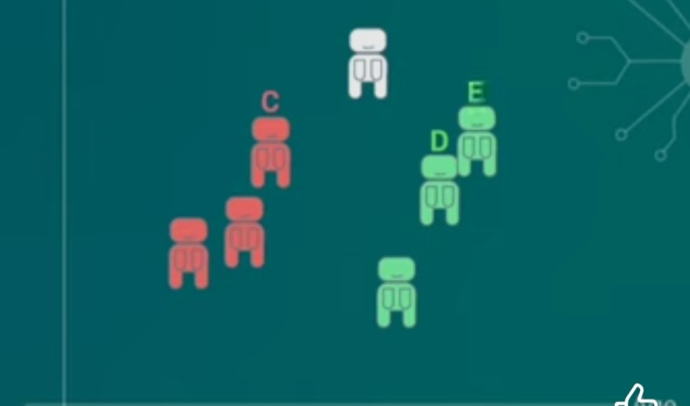

Slide 11
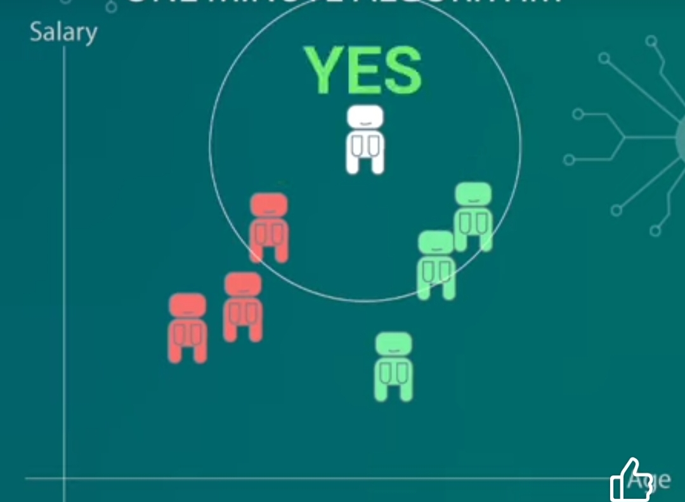

Slide 12
KNN CLASSIFIER CODE {IRIS DATA SET }
import numpy as np
import pandas as pd
from sklearn.model_selection import train_test_split
from sklearn.preprocessing import StandardScaler
from sklearn.neighbors import KNeighborsClassifier
from sklearn.metrics import accuracy_score

Slide 13
Numpy : used for handling arrays and numerical operations .
Pandas :for data manipulation
Train_test_split : A function from sklearn that splits the dataset into training and testing subsets.
Standardscaler : used to standardize the feature data (imp for distance based algorithm like KNN)
kNeighborsclassifier : the KNN algorithm implementation from sklearn library.
Accuracy_score : used to calculate the accuracy of the model by comparing predicted and actual labels.

Slide 14
# Load dataset (Iris dataset)
from sklearn.datasets import load_iris
iris = load_iris()
X = iris.data # Features
y = iris.target # Labels
Load_iris() : loads the iris dataset which is a bulit in dataset in sklearn.it contains 150 samples of iris flower with four features (sepal lenth,sepal width,petal lenth,petal width) for each sample and the target variable (species of flower)
Iris.data : contains the feature data (shape :150 samples * 4 features )
Iris.target : contains the corresponding labels (species) for each sample (3 possible classes :0,1,2)

Slide 15
# Split dataset into training (80%) and testing (20%) sets
X_train, X_test, y_train, y_test = train_test_split(X, y, test_size=0.2, random_state=42)
X: the feature data (inputs)
Y : the target labels (outputs)
test_size =0.2 : Allocates 20% of data to the tset set,leaving 80% for training.
Random_state =42 :ensure reproducibility by setting the seed for random splitting .
# Standardize features (recommended for KNN)
scaler = StandardScaler()
X_train = scaler.fit_transform(X_train)
X_test = scaler.transform(X_test)
fit_transform(X_train) : Fits the scaler to the training data and then transform it to have a mean of 0 and standard deviation of 1.

Slide 16
# Choose K and create KNN classifier
k = 3 # Optimal K can be chosen using cross-validation
knn = KNeighborsClassifier(n_neighbors=k) # [initialize KNN for classifier with K=3.
# Train the model
knn.fit(X_train, y_train)
# fit(X_train,Y_train) means trains KNN model using training data.
# Make predictions
y_pred = knn.predict(X_test)
# predict(X_test): use the KNN classifier to predict the labels for the test data.It calculates the distance of each test sample from the training samples and assign the most common label among the K nearest neighbors.
# Evaluate accuracy
accuracy = accuracy_score(y_test, y_pred)
print(f"KNN Classifier Accuracy: {accuracy:.2f}")
Compare true labels(y_test) with the predicted labels (y_predict)
Output the accuracy rounded to two decimal values .

Slide 17
k-Nearest Neighbors (k-NN), several key hyperparameters significantly influence the model's performance. Here’s an overview of the most important ones and strategies for tuning them:
1. Number of Neighbors (k)
Definition: k represents the number of nearest neighbors to consider when classifying a data point or predicting a value.
Effect:
Small k: Model becomes sensitive to noise (overfitting), as it relies on very few neighbors.
Large k: Model becomes more generalized but may overlook local patterns (underfitting).
Tuning Strategy:
Cross-Validation: Use techniques like k-fold cross-validation to test various values of k and select the one with the lowest error rate.
Odd Numbers for Classification: For binary classification tasks, odd values of k help avoid ties.
Rule of Thumb: Start with k = √n, where n is the number of data points, and adjust based on performance.

Slide 18
Number of Neighbors (k):
What it is: The number of closest data points the algorithm looks at to make a decision.
Example:
If k = 3, the algorithm looks at the 3 nearest neighbors to decide the class of a new point.
If most of those 3 neighbors are "apples," the new point will be labeled as "apple."
How to choose k:
Small k (like 1 or 3): Can be very sensitive to noise in data.
Large k (like 15 or 20): Makes the model more stable but can miss small patterns.
Tip: Try different k values and see which gives the best results.

Slide 19
Distance Metric
Definition: Determines how the "closeness" between points is calculated.
Common Metrics:
Euclidean Distance: Most common; good for continuous variables.
Manhattan Distance (L1): Useful when features are not continuous or when dealing with high-dimensional sparse data.
Minkowski Distance: A generalization of both Euclidean and Manhattan distances (controlled by a parameter p).
Cosine Similarity: Useful when the magnitude of vectors matters less than their orientation (common in text classification).
Hamming Distance: For categorical data.
Tuning Strategy
Experiment with different metrics using grid search( gridsearchCV-find best value for number of neighbors K and distance metrics P for a KNN classifier )
Param_grid ,gridsearchCV
Consider data characteristics (e.g., use Manhattan distance for high-dimensional data).

Slide 20
Grid search procedure
Define the model
Choose hyperparameters to tune
Create the parameter grid
Set up GridSearchCV
Train the model with Grid Search
Get the best hyperparameters
Evaluate the final model

Slide 21
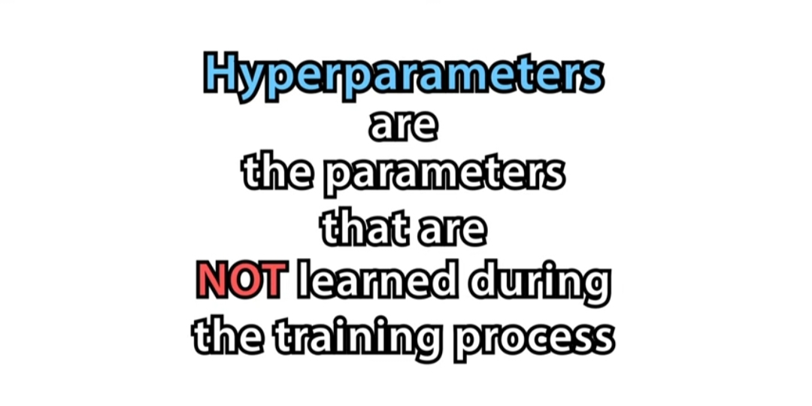
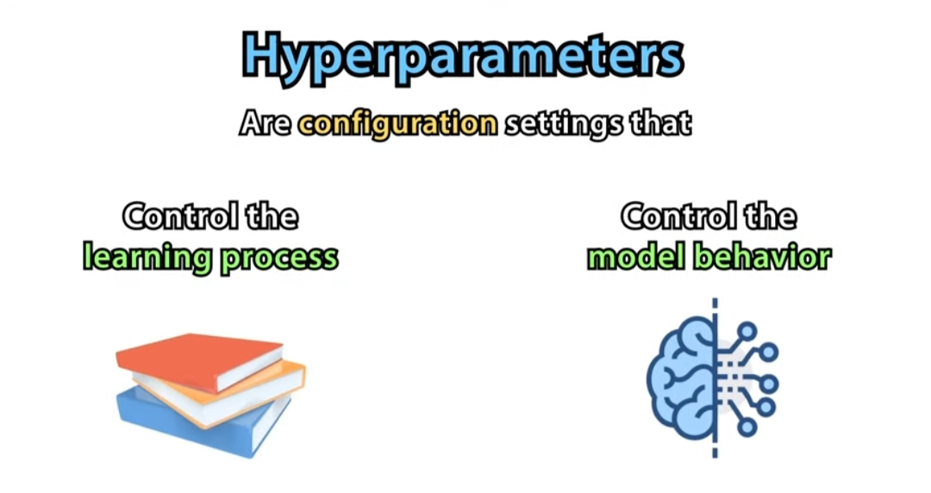
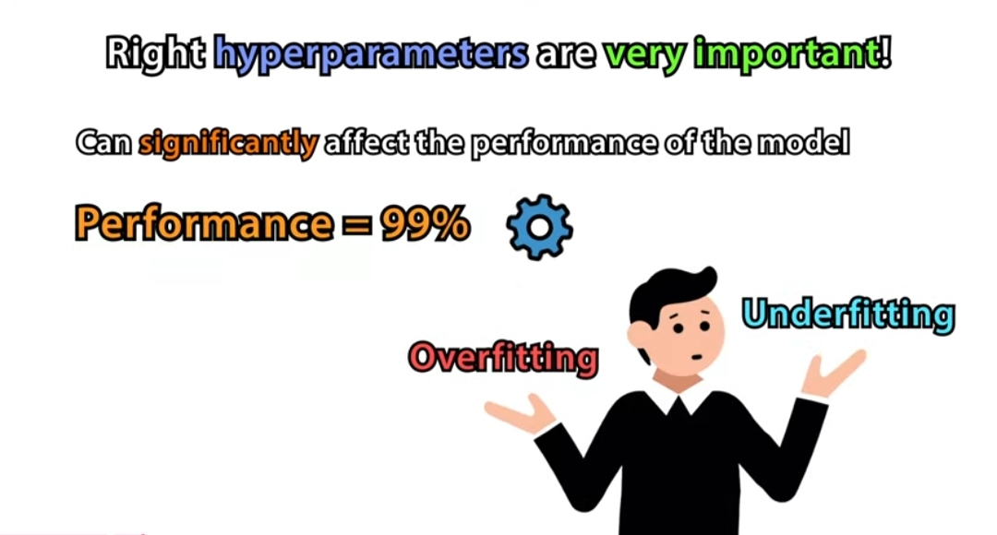
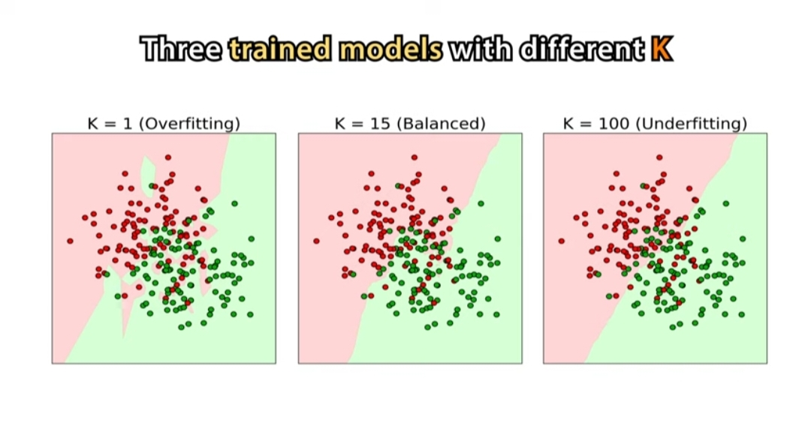
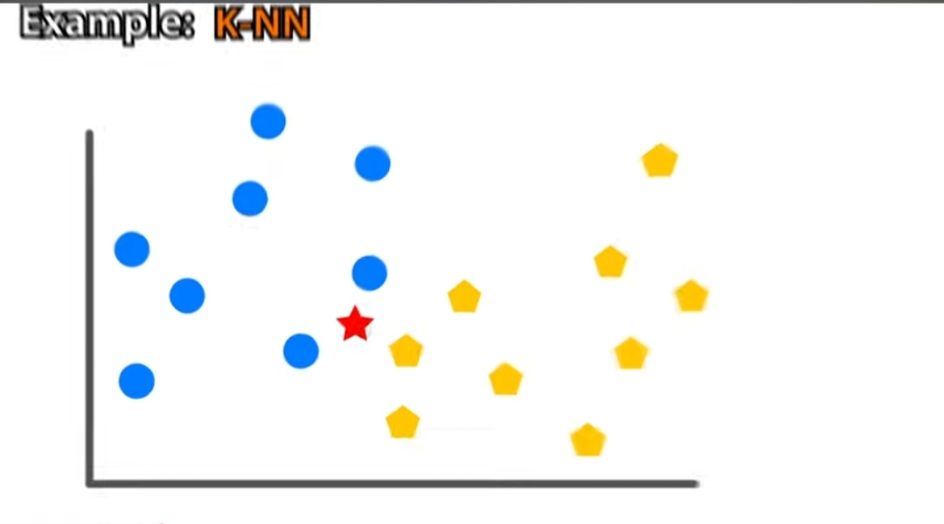
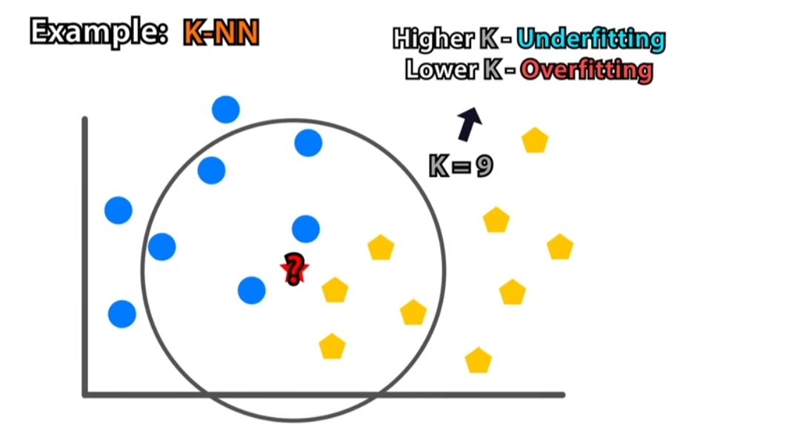

Slide 22
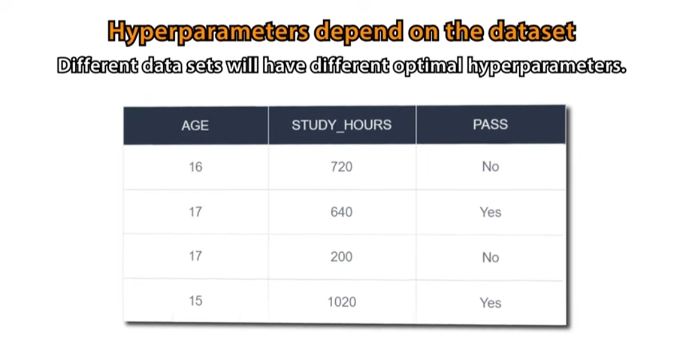
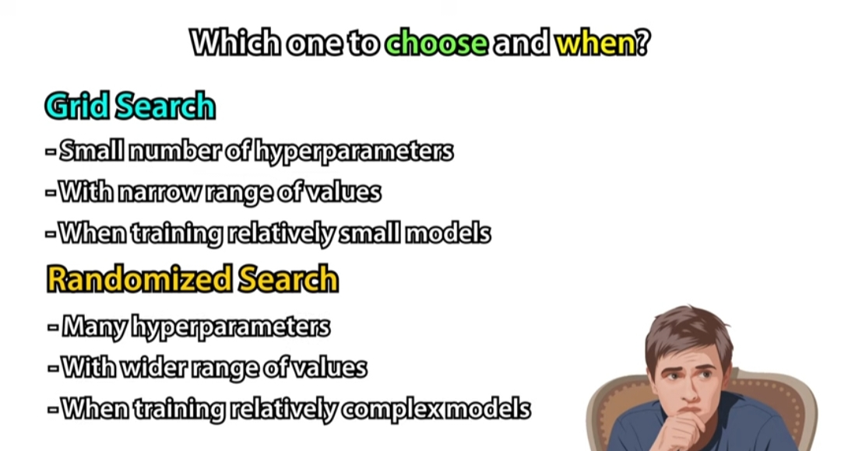
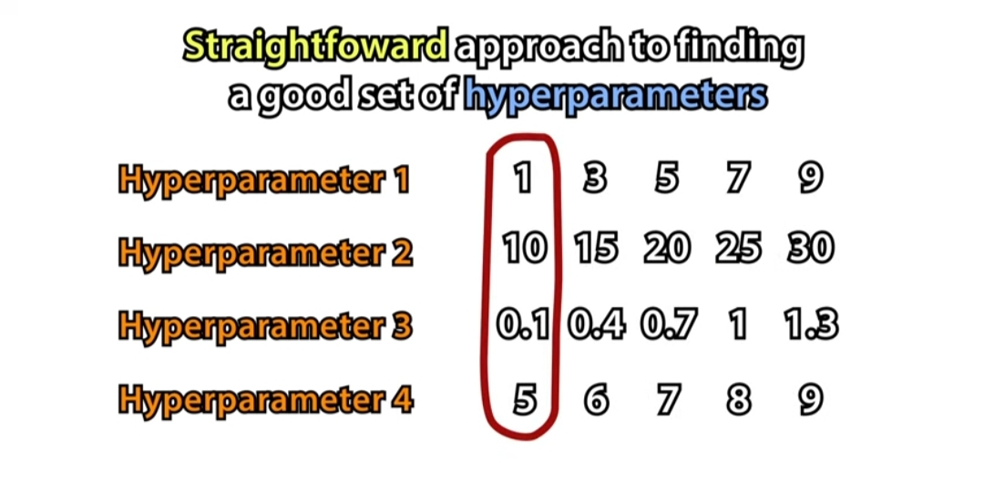
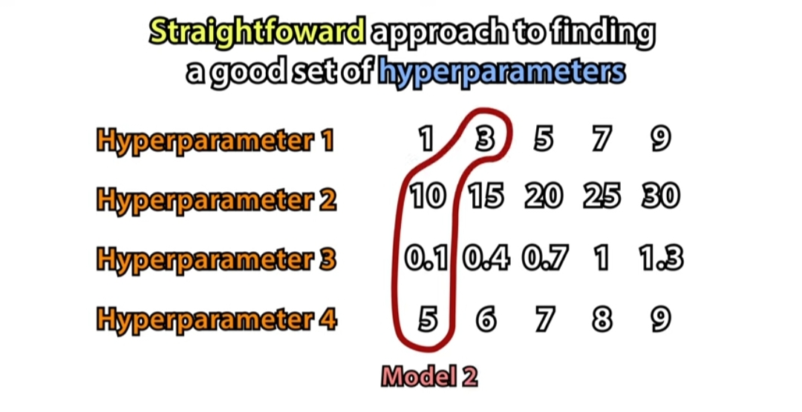
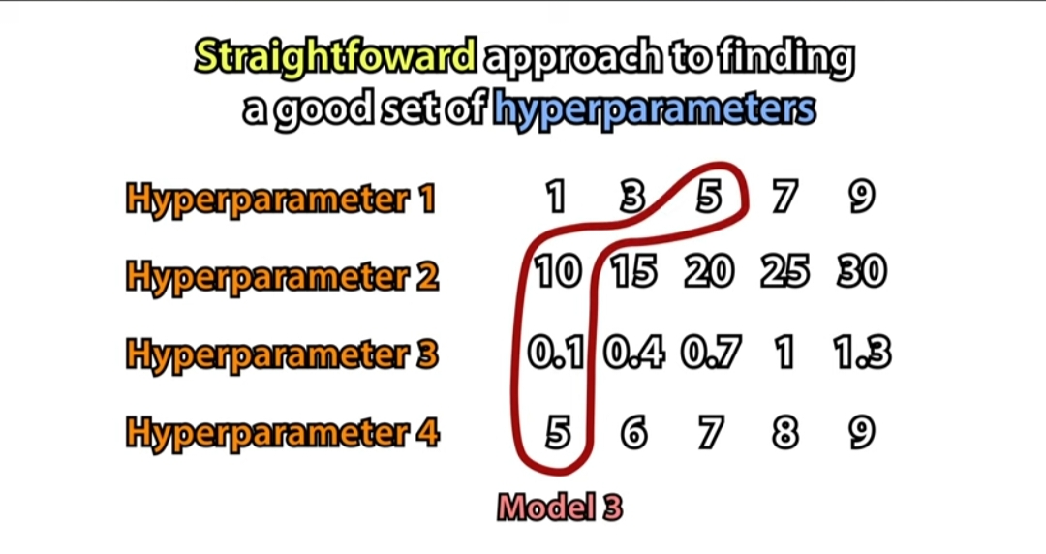

Slide 23
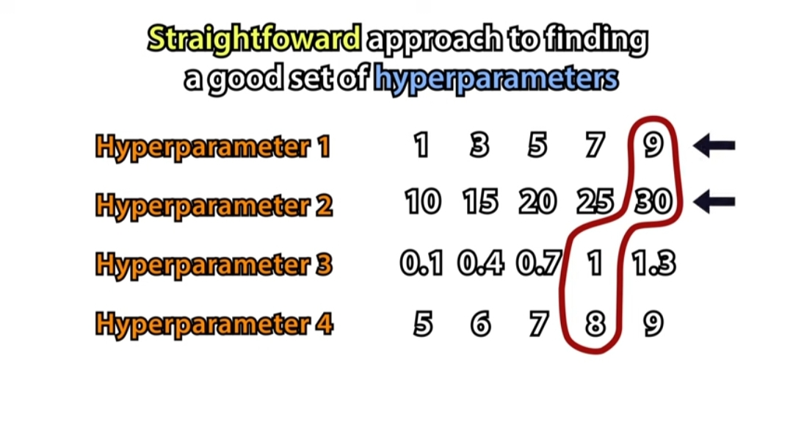
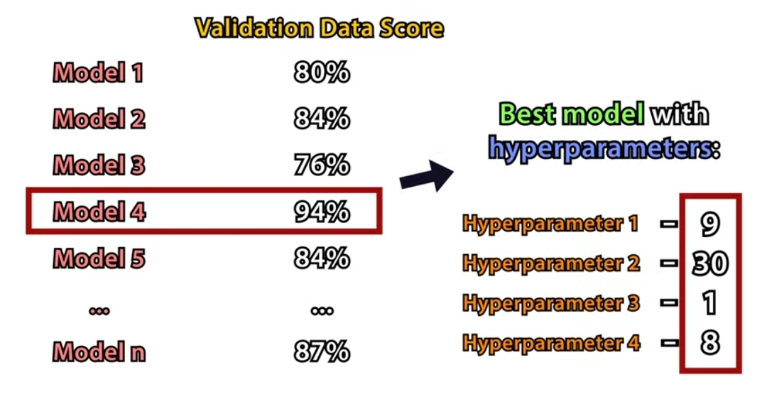
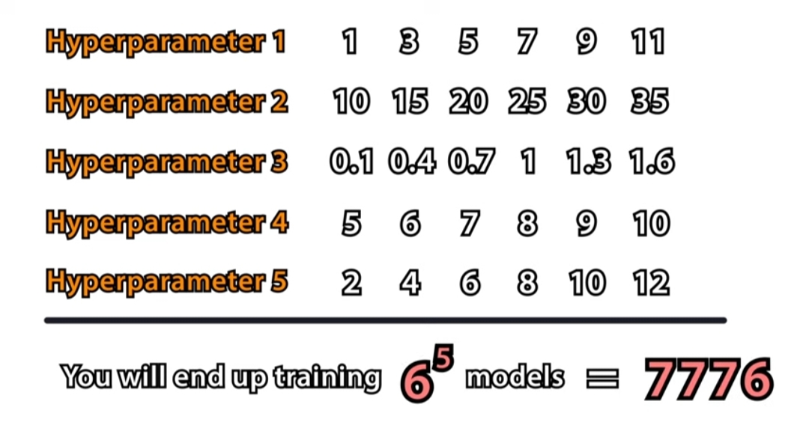
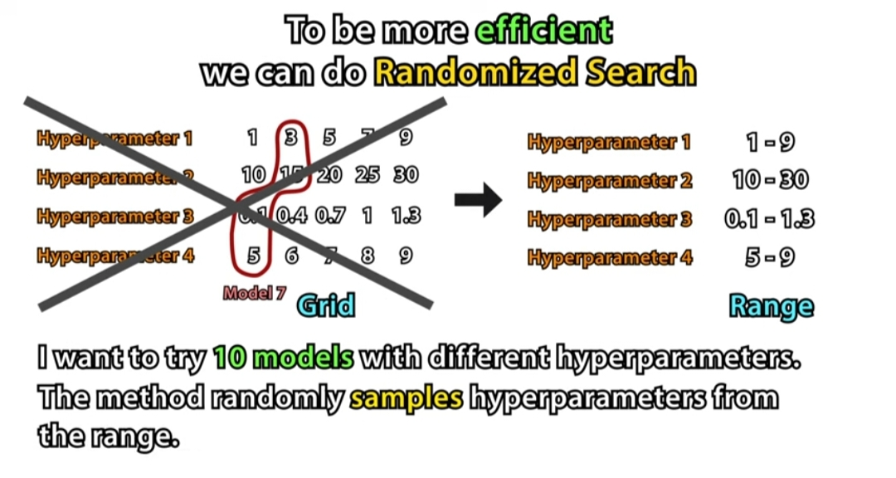
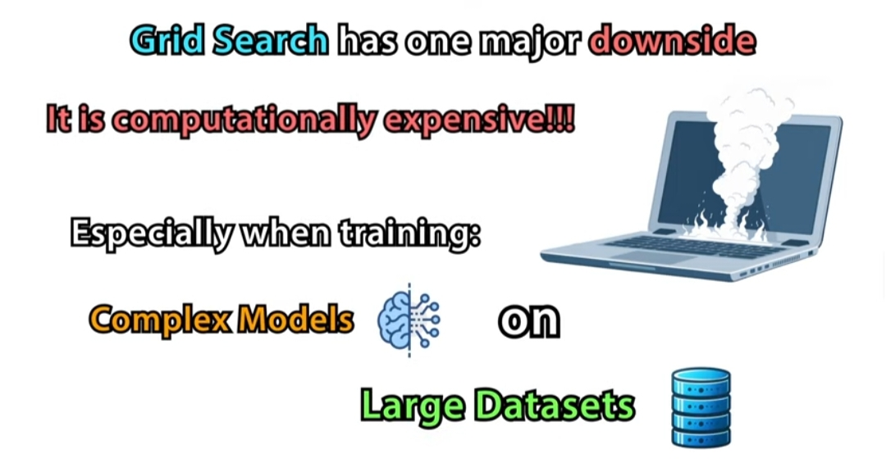

Slide 24
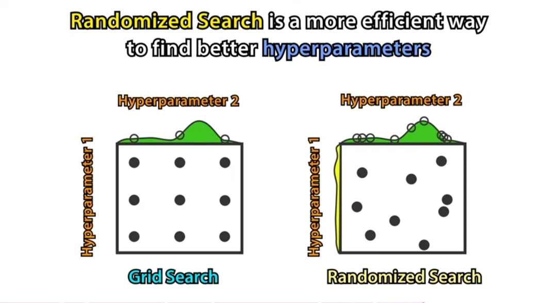

Slide 25
Distance Metric:
What it is: How we measure the "closeness" between points.
Examples:
Euclidean Distance: Like a straight-line distance. Good for normal data.
Manhattan Distance: Like moving on a grid (like streets in a city). Good for high-dimensional data.
Example in real life:
If you’re measuring how far your house is from a store:
Euclidean Distance is like flying in a straight line.
Manhattan Distance is like walking along the streets.

Slide 26
Weight of Neighbors:
What it is: Decides if closer neighbors should have more influence.
Examples:
Uniform: All neighbors have equal say.
Distance: Closer neighbors have more say.
Example:
If you’re asking for restaurant suggestions, you might trust friends who live nearby (distance) more than friends who live far away.

Slide 27
Weight Function
Definition: Determines how much influence each neighbor has on the decision.
Options:
Uniform: All neighbors have equal weight (default setting).
Distance: Closer neighbors have more influence.
Tuning Strategy:
Test both uniform and distance-based weighting using cross-validation.
Distance weighting often improves performance when the dataset has varying densities.
Uniform: Every neighbor has the same power in the decision.
Distance: Closer neighbors have more power in the decision

Slide 28
Radius-Based Nearest Neighbor Algorithm (Radius Neighbors)
The Radius-Based Nearest Neighbor algorithm is a variation of the k-NN algorithm. Instead of choosing a fixed number of neighbors (k), it selects all points within a specified radius (r) around the query point.
How It Works:
Choose a radius (r): This is the distance from the query point.
Find all neighbors within this radius: Instead of picking the closest k points, the algorithm looks for all points that are within the distance r.
Decision making:
For classification: The most common class among the points inside the radius is chosen.
For regression: The average of the values inside the radius is taken.

Slide 29
R-D NN algorithm steps :
Step 1 : Calculate the distance between the query point and each training point.
Step 2:Filter the points that are within
the given radius
Step 3 : classify the query point using the majority label of the neighbors.

Slide 30
KNN | k-NN Radius-Based Neighbors
Selects exactly k neighbors | Selects all neighbors within radius r
Always returns k points | Number of points can vary (0 or many)
Fixed neighbors, distance may vary | Fixed distance, neighbors may vary

Slide 31
Example:
Imagine a circle around your house with a radius of 1 km.
In k-NN, you might always ask your 3 closest neighbors, even if they live 5 km away.
In Radius-Based Neighbors, you ask everyone within 1 km of your house. If no one lives within 1 km, no neighbors are considered.
What If No Neighbors Are Found?
If no points are found within the radius, the algorithm may:
Return no prediction.
Use a default value.
You can adjust the radius to avoid this issue.

Slide 32
When to Use Radius-Based Neighbors:
When you want flexibility in how many neighbors to consider.
When you have unevenly distributed data and want to focus only on close points.
When you want to ignore distant points that might not be relevant.

Slide 33
Practical Use Cases:
Anomaly Detection:
Why: Outliers (anomalies) often have no nearby neighbors.
Example: Detecting fraudulent transactions in banking. If a transaction has no similar transactions within a certain radius, it might be flagged as suspicious.
Geographic Applications:
Why: Physical distance matters in real-world geography.
Example: Classifying real estate properties based on nearby property prices. Only properties within a certain distance are considered to predict the price.
Medical Diagnosis:
Why: Only similar patient cases (within a certain health metric range) are relevant.
Example: Classifying disease types based on medical measurements (e.g., blood pressure, heart rate). Only patients with similar symptoms within a certain range influence the diagnosis.
Recommender Systems:
Why: Recommendations can be based on items within a similarity radius.
Example: Suggesting movies to a user based on other users with similar preferences within a certain similarity threshold.
Environmental Monitoring:
Why: Only consider data from nearby sensors.
Example: In smart agriculture, determining soil moisture levels based on readings from sensors within a certain distance from a crop field.

Slide 34
import numpy as np R-D NN USING SYNTHETIC DATA
import matplotlib.pyplot as plt
# Create simple synthetic data (2 classes)
X = np.array([[1, 2], [2, 3], [3, 3], [6, 5], [7, 8], [8, 8]]) # Data points
y = np.array([0, 0, 0, 1, 1, 1]) # Labels (0 or 1)
# Function to classify a new point using radius
def radius_classify(X, y, new_point, radius):
distances = np.linalg.norm(X - new_point, axis=1) # Calculate distances
neighbors = y[distances <= radius] # Find neighbors within radius
if len(neighbors) == 0:
return "No neighbors found"
# Return the most common class
return np.bincount(neighbors).argmax()

Slide 35
# Classify a new point
new_point = np.array([4, 4])
result = radius_classify(X, y, new_point, radius=2.5)
print("Class of the new point:", result)
plt.legend()
plt.title("Radius-Based Neighbor Classification")
plt.xlabel("Feature 1")
plt.ylabel("Feature 2")
plt.show()

Slide 36
Regression :
In machine learning is a type of supervised learning algorithm used to predict a continuous output variable based on one or more input features. The goal of regression is to model the relationship between the independent variables (features) and the dependent variable (target) so that we can predict the value of the target for new, unseen data.
Key Concepts in Regression:
Dependent Variable (Target): The outcome you're trying to predict (e.g., house price, temperature).
Independent Variables (Features): The input variables used to predict the target (e.g., square footage, number of rooms).

Slide 37
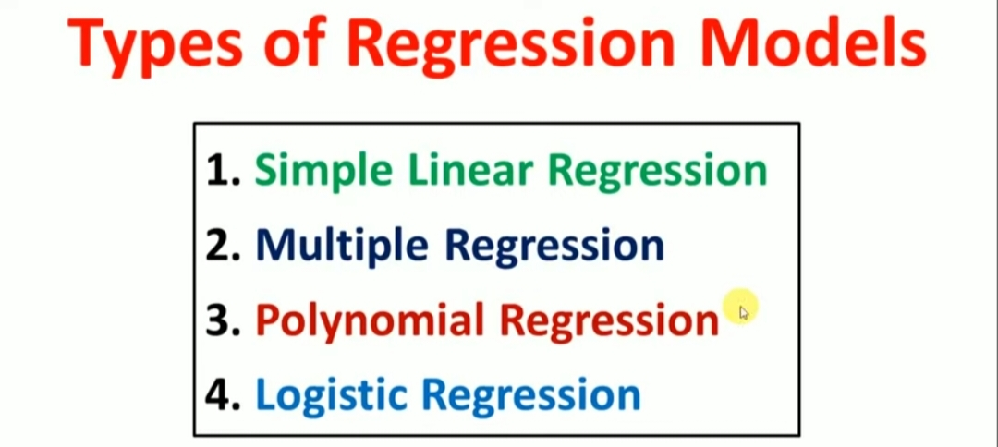

Slide 38
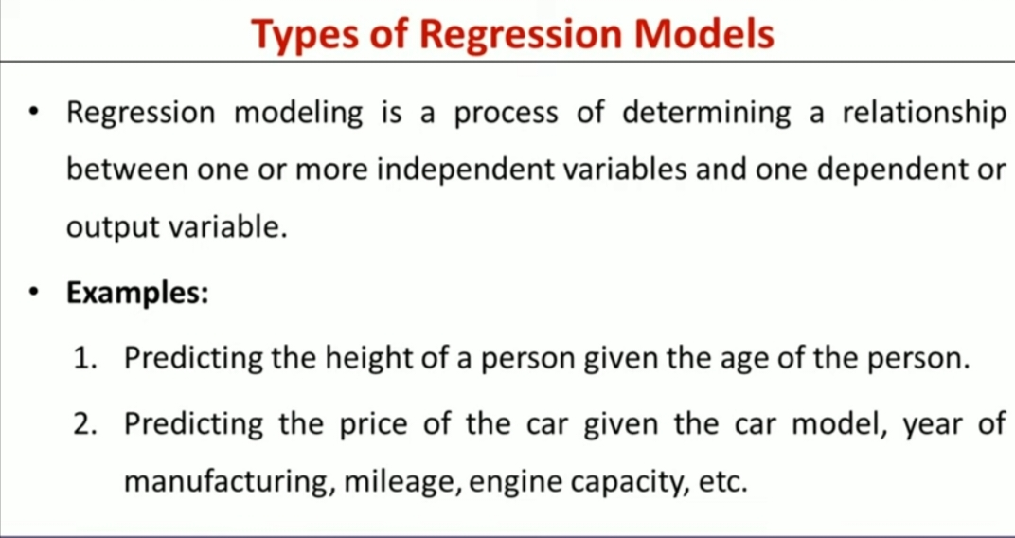

Slide 39
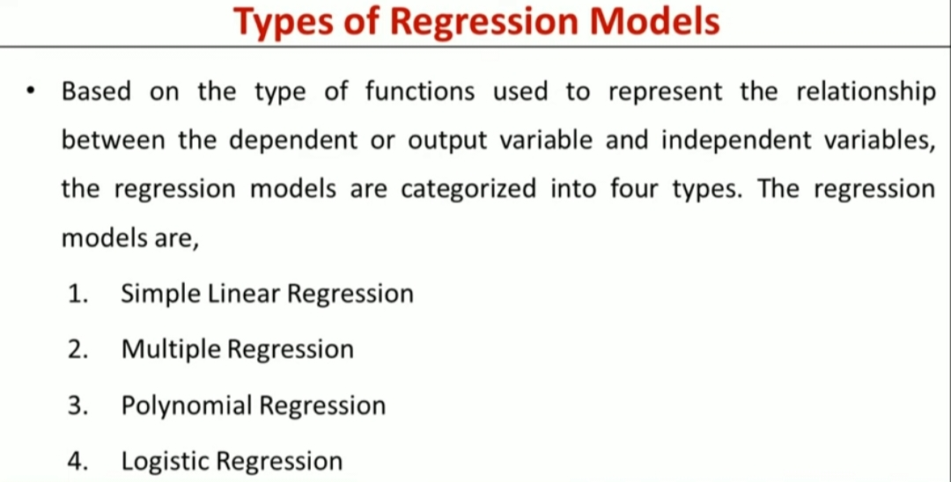

Slide 40
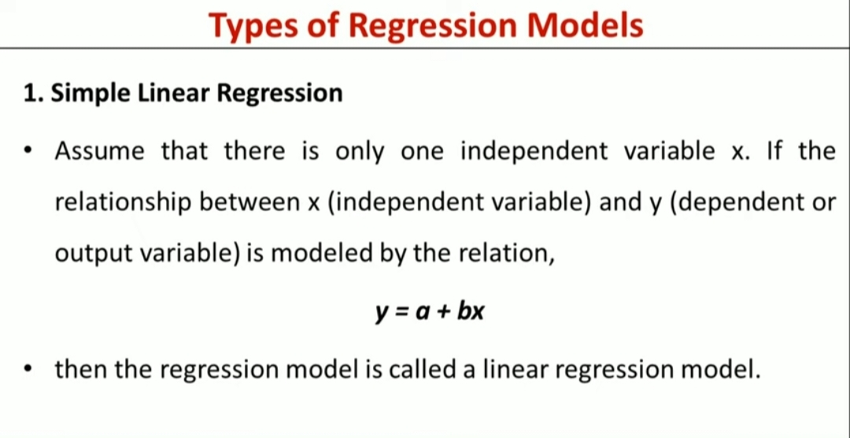

Slide 41
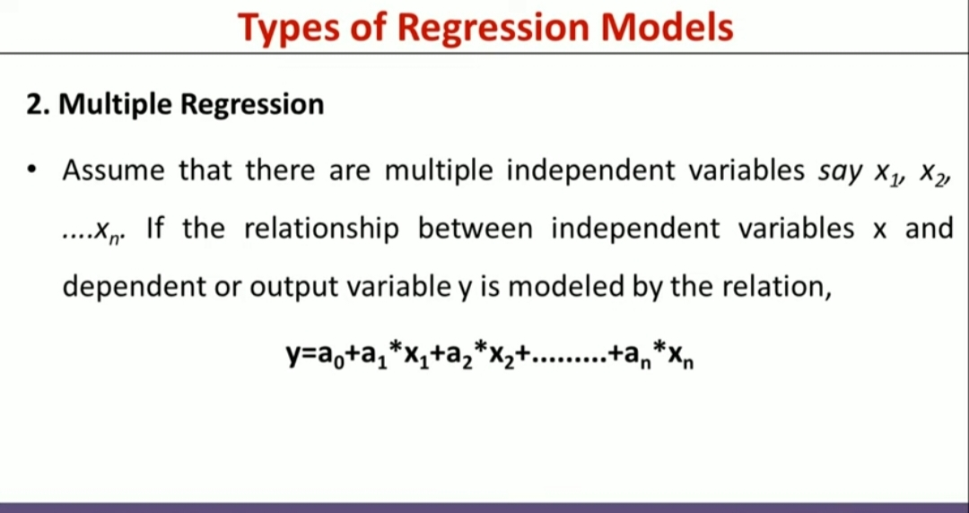

Slide 42
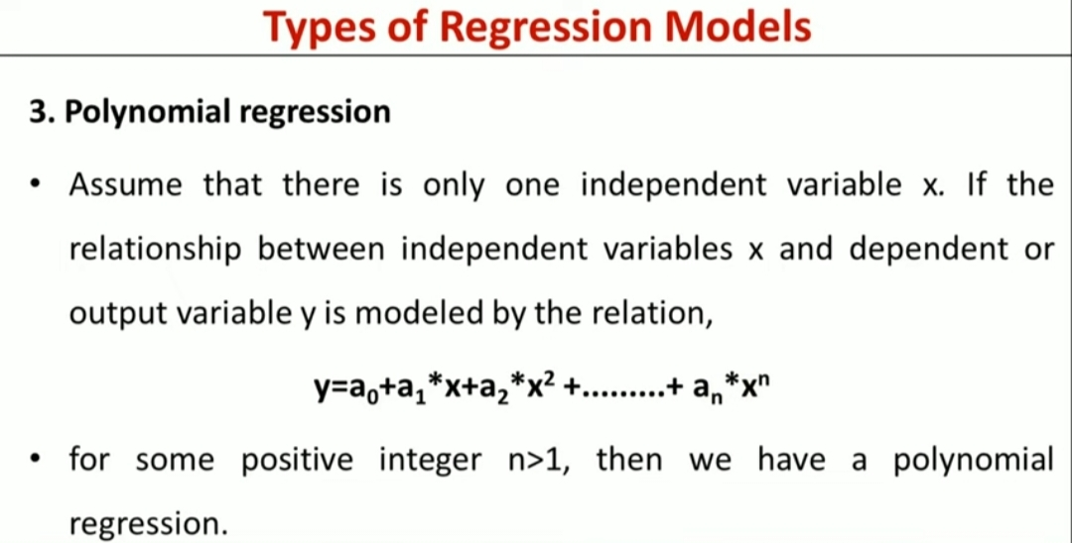

Slide 43
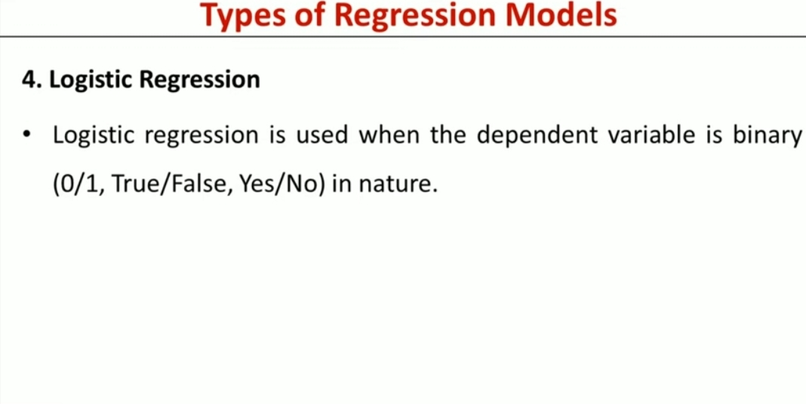

Slide 44
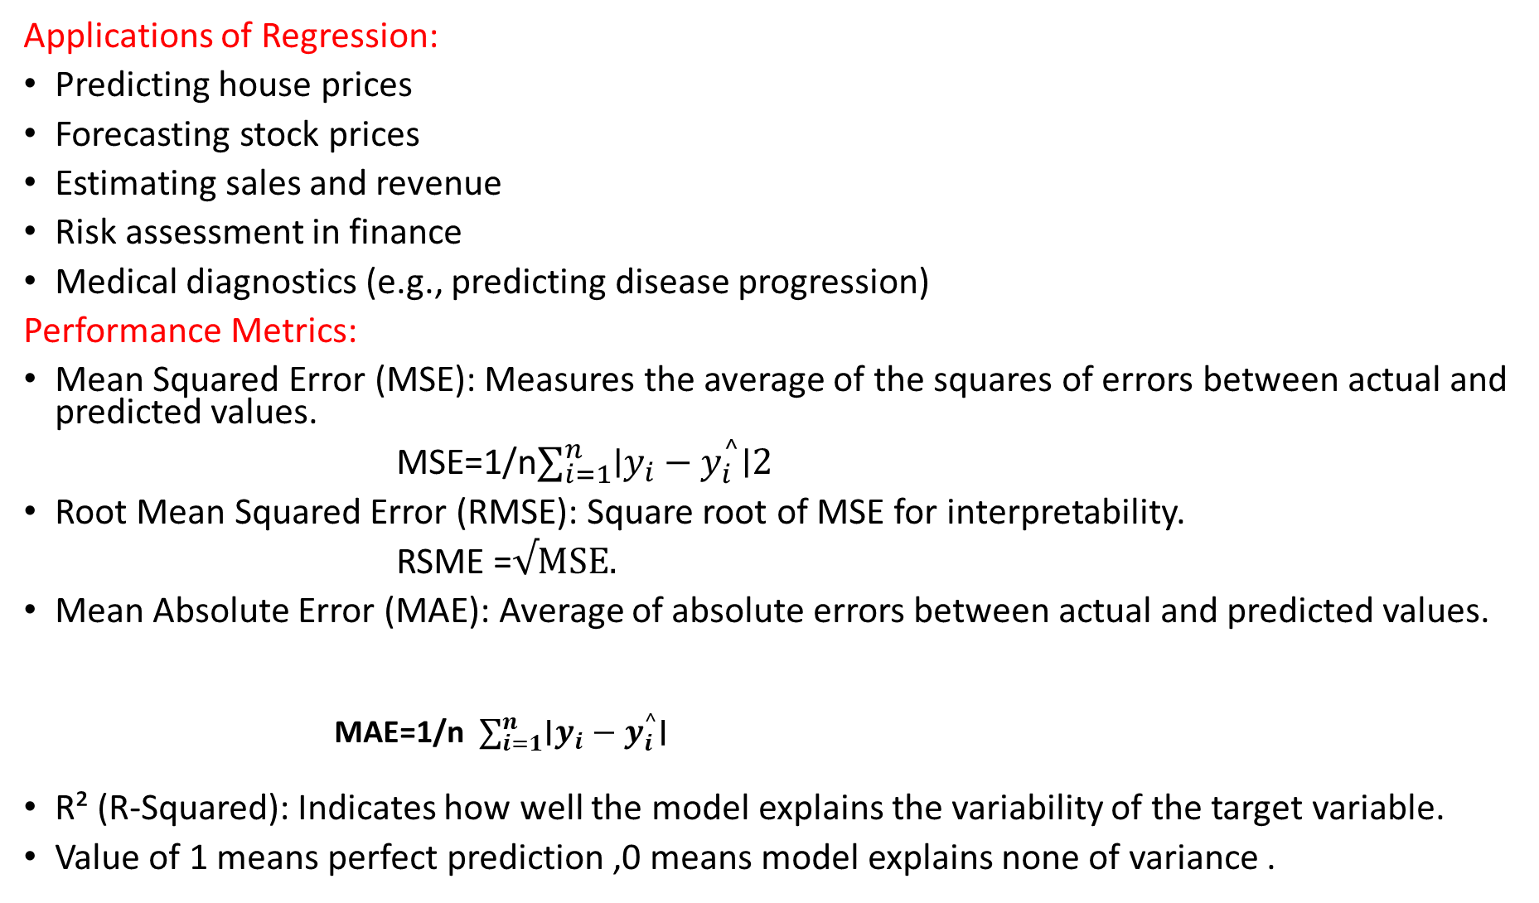
Applications of Regression:
Predicting house prices
Forecasting stock prices
Estimating sales and revenue
Risk assessment in finance
Medical diagnostics (e.g., predicting disease progression)
Performance Metrics:
Mean Squared Error (MSE): Measures the average of the squares of errors between actual and predicted values.
MSE=1/n$∑_{i=1}^{n}$∣$y_{i}−y_{i}^{^}$∣2
Root Mean Squared Error (RMSE): Square root of MSE for interpretability.
RSME =√MSE.
Mean Absolute Error (MAE): Average of absolute errors between actual and predicted values.
          MAE=1/n${ ∑}_{i=1}^{n}$∣$y_{i}−y_{i}^{^}$∣
R² (R-Squared): Indicates how well the model explains the variability of the target variable.
Value of 1 means perfect prediction ,0 means model explains none of variance .

Slide 45
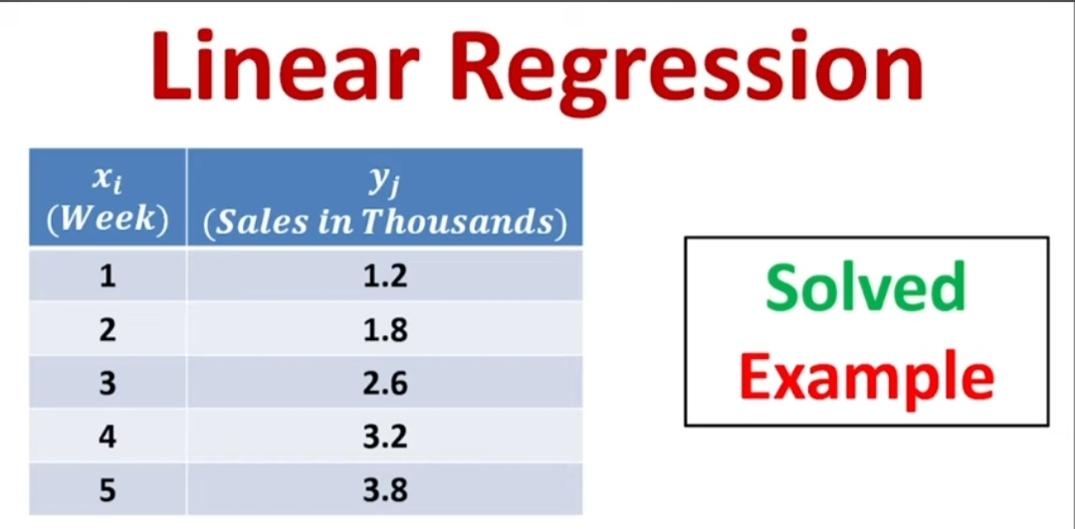

Slide 46
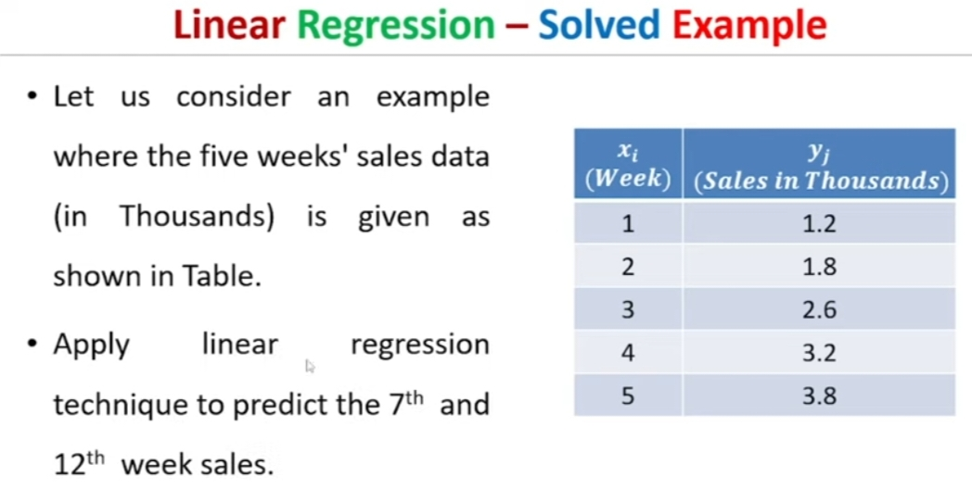

Slide 47
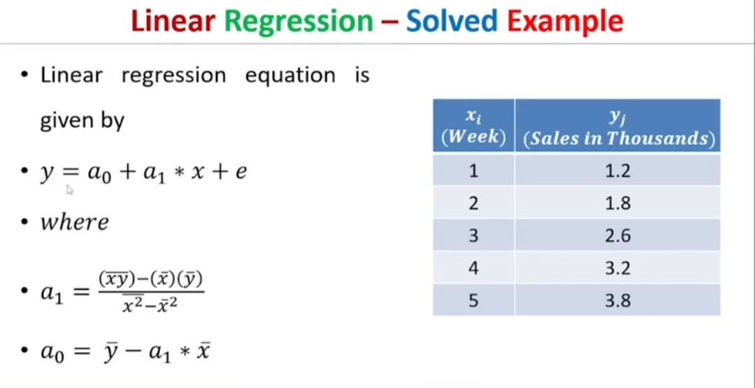

Slide 48
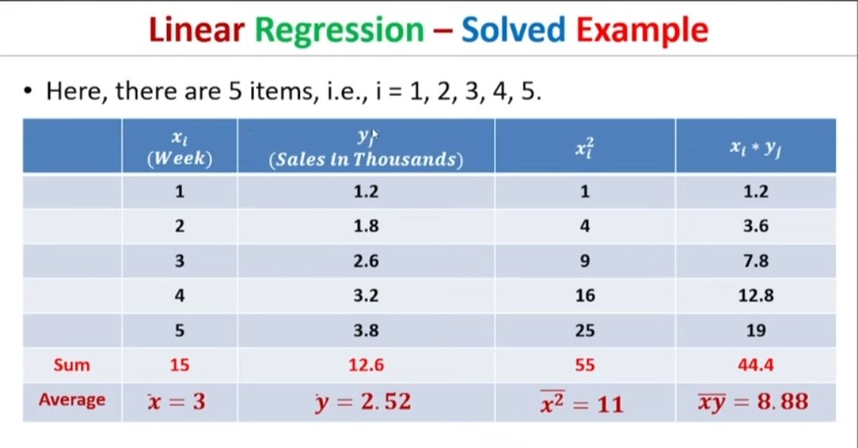

Slide 49
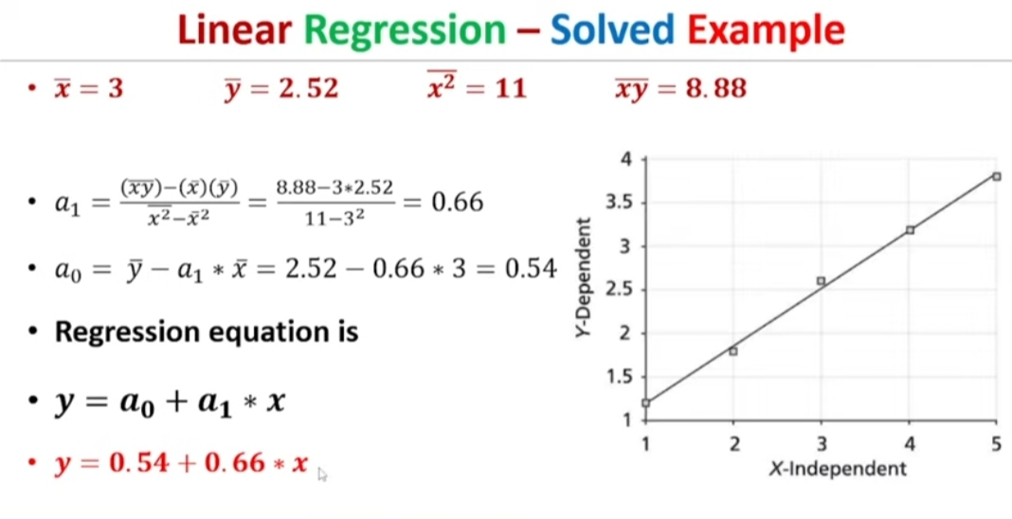

Slide 50
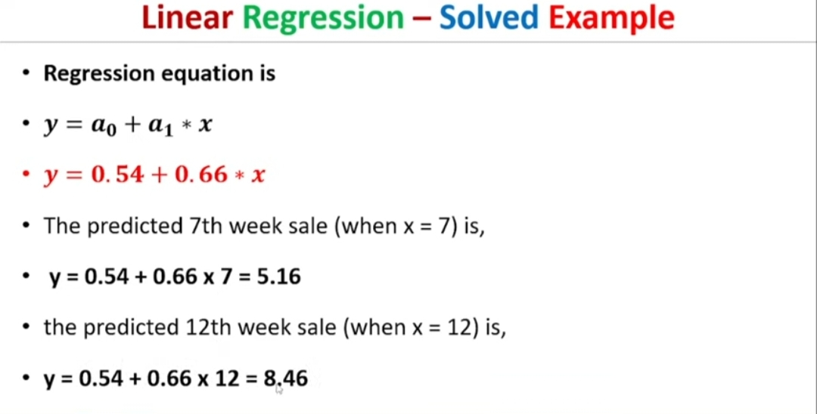

Slide 51
KNN (K-Nearest Neighbors) regression is a non-parametric, instance-based learning algorithm used to predict continuous values. It works by finding the 'k' closest training samples to the query point and averaging their target values to make the prediction.
The main steps involve:
Step 1: Selecting a value for 'k' (number of neighbors).
Step 2 : Calculating the distance (commonly Euclidean) between the query point and all other points in the dataset.
Step 3 : Identifying the k nearest neighbors.
Step 4 : Averaging the target values of these neighbors to generate the prediction.
KNN regression assumes that similar input points have similar output values.

Slide 52
Workflow of KNN Regression
Step-by-Step Workflow:
Load Data:
Load the dataset with features like house size, number of rooms, etc., and the target (house price).
Preprocessing:
Handle missing values if any.
Scale the data for accurate distance calculation (since KNN is distance-based).
Split the Data:
Divide the data into training and testing sets.
Choose k (Number of Neighbors):
Decide how many neighbors to consider for making predictions.
Prediction:
For a given new data point (e.g., house features), find the k nearest neighbors.
Average the prices of these neighbors to predict the price.
Evaluation:
Use metrics like Mean Squared Error (MSE) or R² Score to evaluate performance.

Slide 53
from sklearn.datasets import load_boston KNN REGRESS –BOSTON HOUSE
from sklearn.model_selection import train_test_split
from sklearn.preprocessing import StandardScaler
from sklearn.neighbors import KNeighborsRegressor
from sklearn.metrics import mean_squared_error, r2_score
import matplotlib.pyplot as plt
# Step 1: Load Dataset
boston = load_boston()
X = boston.data # Features (e.g., number of rooms, location)
y = boston.target # Target (house price)
# Step 2: Split Data into Training and Testing Sets
X_train, X_test, y_train, y_test = train_test_split(X, y, test_size=0.2, random_state=42)

Slide 54
# Step 3: Scale the Data (Important for KNN)
scaler = StandardScaler()
X_train_scaled = scaler.fit_transform(X_train)
X_test_scaled = scaler.transform(X_test)
# Step 4: Train KNN Regressor
knn_regressor = KNeighborsRegressor(n_neighbors=5) # Using k=5 neighbors
knn_regressor.fit(X_train_scaled, y_train)
# Step 5: Make Predictions
y_pred = knn_regressor.predict(X_test_scaled)

Slide 55
import numpy as np
import pandas as pd
import matplotlib.pyplot as plt
from sklearn.datasets import fetch_california_housing # Replacing Boston dataset
from sklearn.model_selection import train_test_split
from sklearn.preprocessing import StandardScaler
from sklearn.neighbors import KNeighborsRegressor
from sklearn.metrics import mean_squared_error, r2_score
# Load the California housing dataset (Boston dataset is deprecated)
housing = fetch_california_housing()
X = pd.DataFrame(housing.data, columns=housing.feature_names)
y = pd.DataFrame(housing.target, columns=["MEDV"]) # House prices
# Split data into training (80%) and testing (20%)
X_train, X_test, y_train, y_test = train_test_split(X, y, test_size=0.2, random_state=42)

Slide 56
# Normalize features (KNN is sensitive to scale)
scaler = StandardScaler()
X_train_scaled = scaler.fit_transform(X_train)
X_test_scaled = scaler.transform(X_test)
# Train KNN Regression model with k=5
knn_model = KNeighborsRegressor(n_neighbors=5)
knn_model.fit(X_train_scaled, y_train)
# Make predictions
y_pred = knn_model.predict(X_test_scaled)
# Evaluate performance
mse = mean_squared_error(y_test, y_pred)
r2 = r2_score(y_test, y_pred)
print(f"Mean Squared Error: {mse:.2f}")
print(f"R² Score: {r2:.2f}")
# Plot actual vs. predicted prices
plt.scatter(y_test, y_pred, alpha=0.7)
plt.xlabel("Actual Prices ($1000s)")
plt.ylabel("Predicted Prices ($1000s)")
plt.title("Actual vs Predicted House Prices (KNN Regression)")
plt.show()

Slide 57
import numpy as npimport pandas as pd
import matplotlib.pyplot as plt
from sklearn.datasets import fetch_california_housing # Replacing Boston dataset
from sklearn.model_selection import train_test_split
from sklearn.preprocessing import StandardScaler
from sklearn.neighbors import KNeighborsRegressor
from sklearn.metrics import mean_squared_error, r2_score
# Load the California housing dataset (Boston dataset is deprecated)
housing = fetch_california_housing()
X = pd.DataFrame(housing.data, columns=housing.feature_names)
y = pd.DataFrame(housing.target, columns=["MEDV"]) # House prices

Slide 58
# Step 6: Evaluate the Model
mse = mean_squared_error(y_test, y_pred)
r2 = r2_score(y_test, y_pred)
print(f"Mean Squared Error: {mse:.2f}")
print(f"R² Score: {r2:.2f}")
# Step 7: Visualization
plt.scatter(y_test, y_pred, color='blue')
plt.plot([min(y_test), max(y_test)], [min(y_test), max(y_test)], color='red', linestyle='--')
plt.xlabel("Actual Prices")
plt.ylabel("Predicted Prices")
plt.title("Actual vs Predicted House Prices")
plt.show()

Slide 59
Comparison of k-NN Regression vs Linear Regression
Aspect | k-NN Regression | Linear Regression
Basic Idea | Predicts based on the average of k nearest neighbors' values | Predicts using a linear relationship between features and target
Model Type | Non-parametric (no fixed equation) | Parametric (fixed equation: y = mx + c)
Assumptions | No assumptions about data distribution | Assumes linear relationship between features and target
Flexibility | Highly flexible, can model non-linear relationships | Limited to linear patterns
Performance on Non-Linear Data | Performs well on complex, non-linear data | Performs poorly on non-linear data

Slide 60
Interpretability | Harder to interpret (depends on neighbors) | Easy to interpret (coefficients show feature importance)
Training Time | Fast (stores data, no training phase) | Requires time to fit the model
Prediction Time | Slow for large datasets (needs to compute distances) | Fast (simple equation evaluation)
Sensitivity to Outliers | Sensitive to outliers (if neighbors include outliers) | Can handle outliers better, but still affected
Scalability | Poor scalability for large datasets | Scales well to large datasets

Slide 61
Overfitting Risk | High risk if k is too small | Less prone to overfitting, but can underfit if data isn't linear
Use Cases | Suitable for complex, irregular patterns (e.g., image recognition, non-linear data) | Best for simple, linear relationships (e.g., predicting sales based on price)

Slide 62
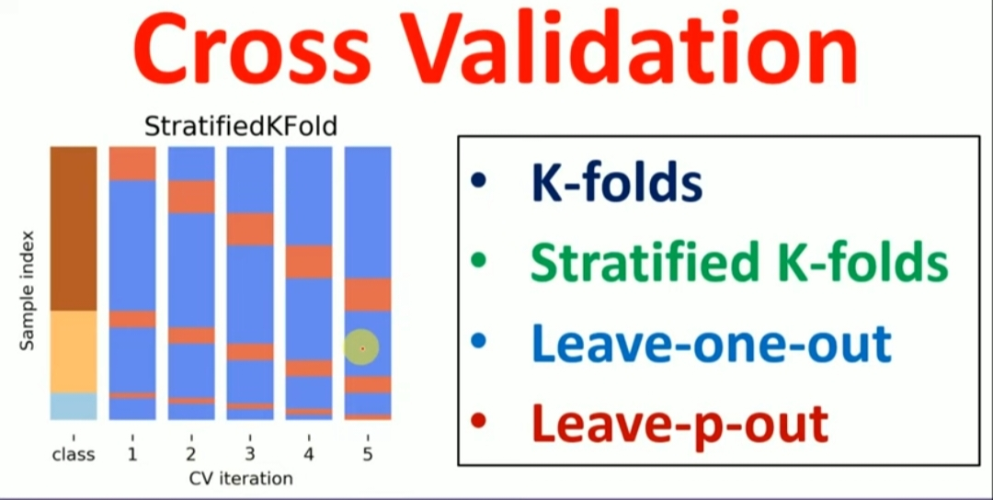

Slide 63
Cross-validation :
is a resampling technique used to evaluate the performance of a machine learning model by dividing the dataset into multiple subsets. It helps assess how well a model generalizes to unseen data by training and testing it on different portions of the dataset.
Key Concept:
The dataset is split into k subsets (or "folds"), and the model is trained on k-1 folds while tested on the remaining fold. This process is repeated k times, with each fold serving as the test set once. The final performance is the average of all iterations.

Slide 64
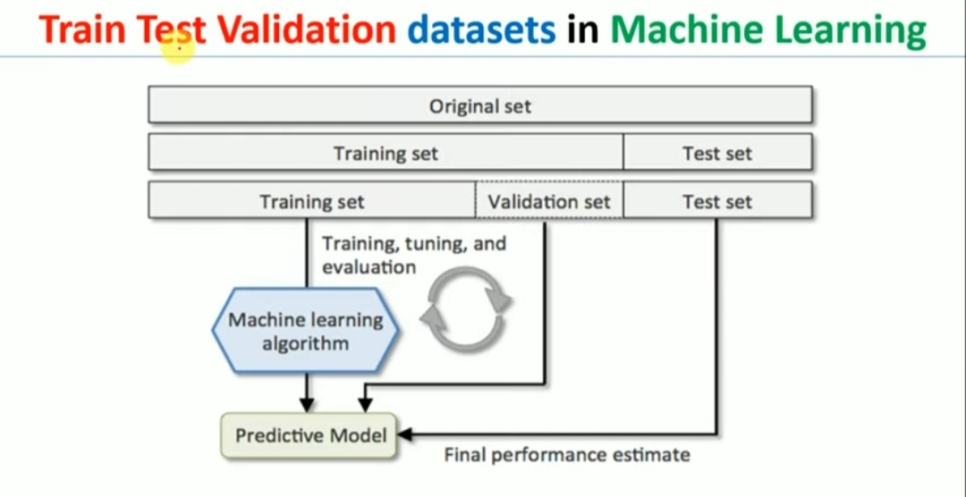

Slide 65
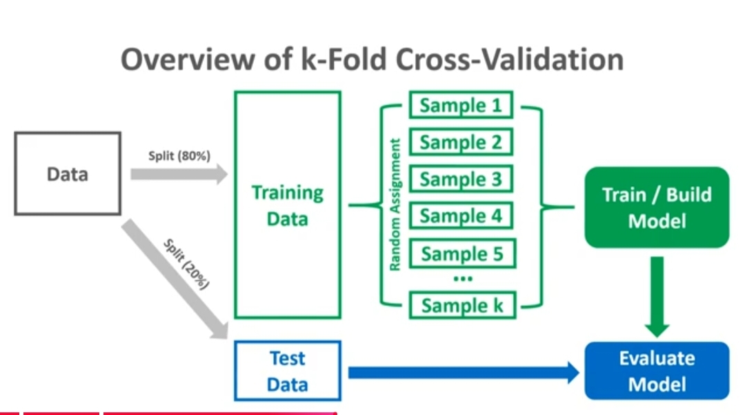
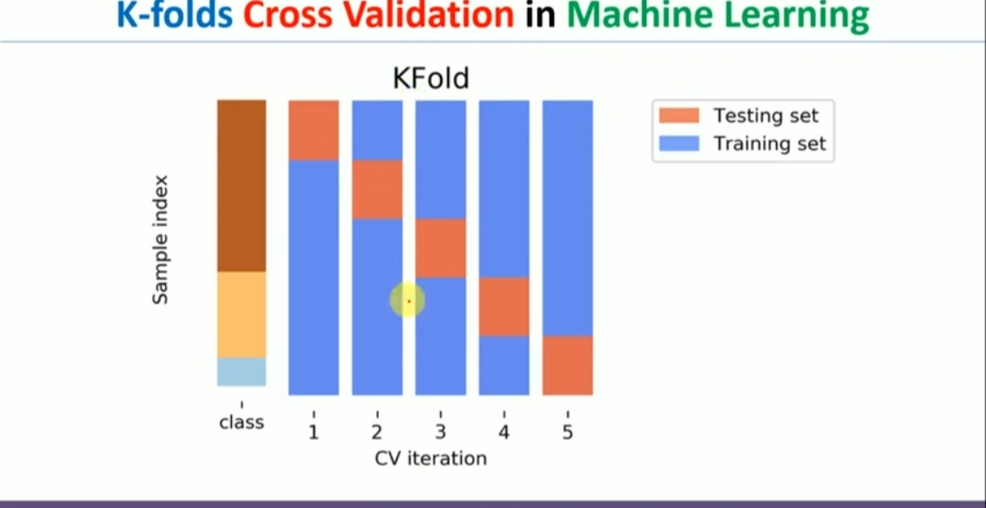
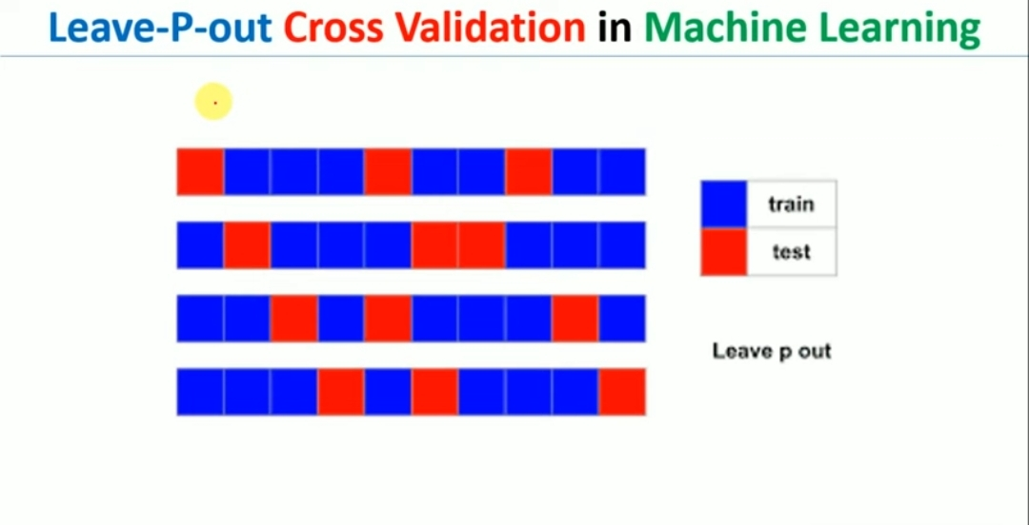
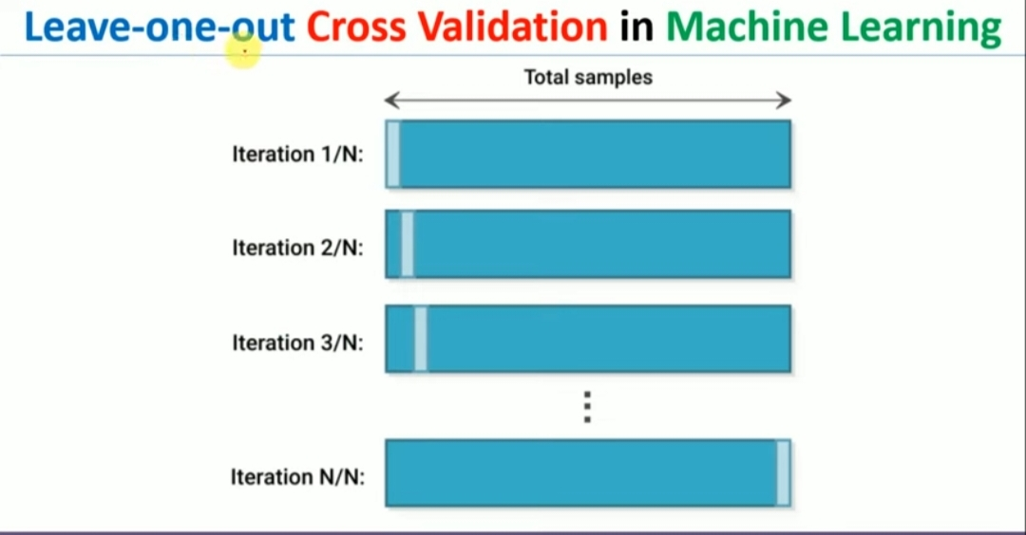

Slide 66
Cross-validation helps improve k-NN model selection
By finding the best value of k (number of neighbors) that gives the most accurate predictions.
How it works:
Split the data into parts (e.g., 5 or 10 folds).
Train the k-NN model on some parts and test it on the remaining part.
Repeat this process, changing the test part each time.
Average the accuracy from all rounds to see how well the model performs.
Try different k values (like k=1, 3, 5, 7) and pick the one with the highest average accuracy.
Example:
Imagine you are classifying fruits based on size and color.
You try k=3 and get 85% accuracy after cross-validation.
You try k=5 and get 90% accuracy.
You try k=7 and get 88% accuracy.
Since k=5 gives the best accuracy, you choose it for your final k-NN model.
This process helps avoid overfitting (too specific) or underfitting (too general) by selecting the best k for your data.

Slide 67
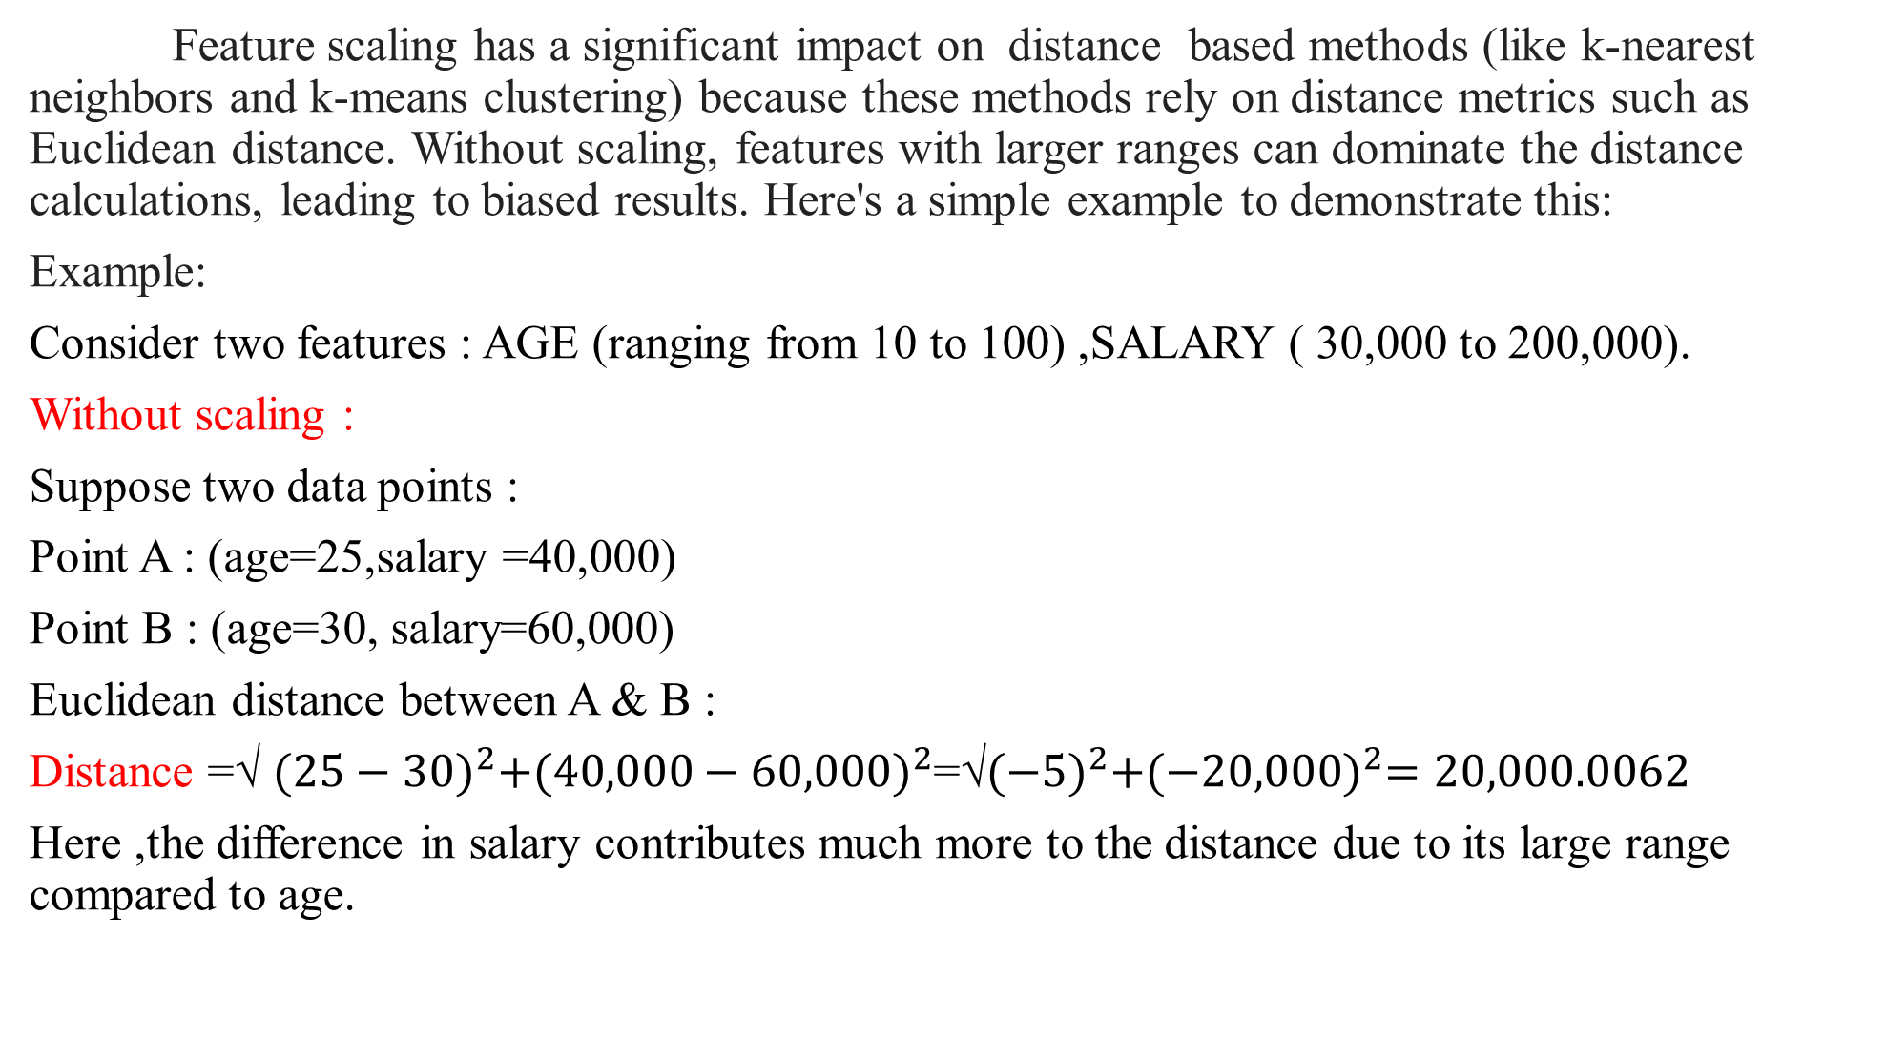
Feature scaling has a significant impact on distance based methods (like k-nearest neighbors and k-means clustering) because these methods rely on distance metrics such as Euclidean distance. Without scaling, features with larger ranges can dominate the distance calculations, leading to biased results. Here's a simple example to demonstrate this:
Example:
Consider two features : AGE (ranging from 10 to 100) ,SALARY ( 30,000 to 200,000).
Without scaling :
Suppose two data points :
Point A : (age=25,salary =40,000)
Point B : (age=30, salary=60,000)
Euclidean distance between A & B :
Distance =√ ${(25−30)}^{2}+{(40,000−60,000)}^{2}$=√${(−5)}^{2}+{(−20,000)}^{2}=20,000.0062$
Here ,the difference in salary contributes much more to the distance due to its large range compared to age.

Slide 68
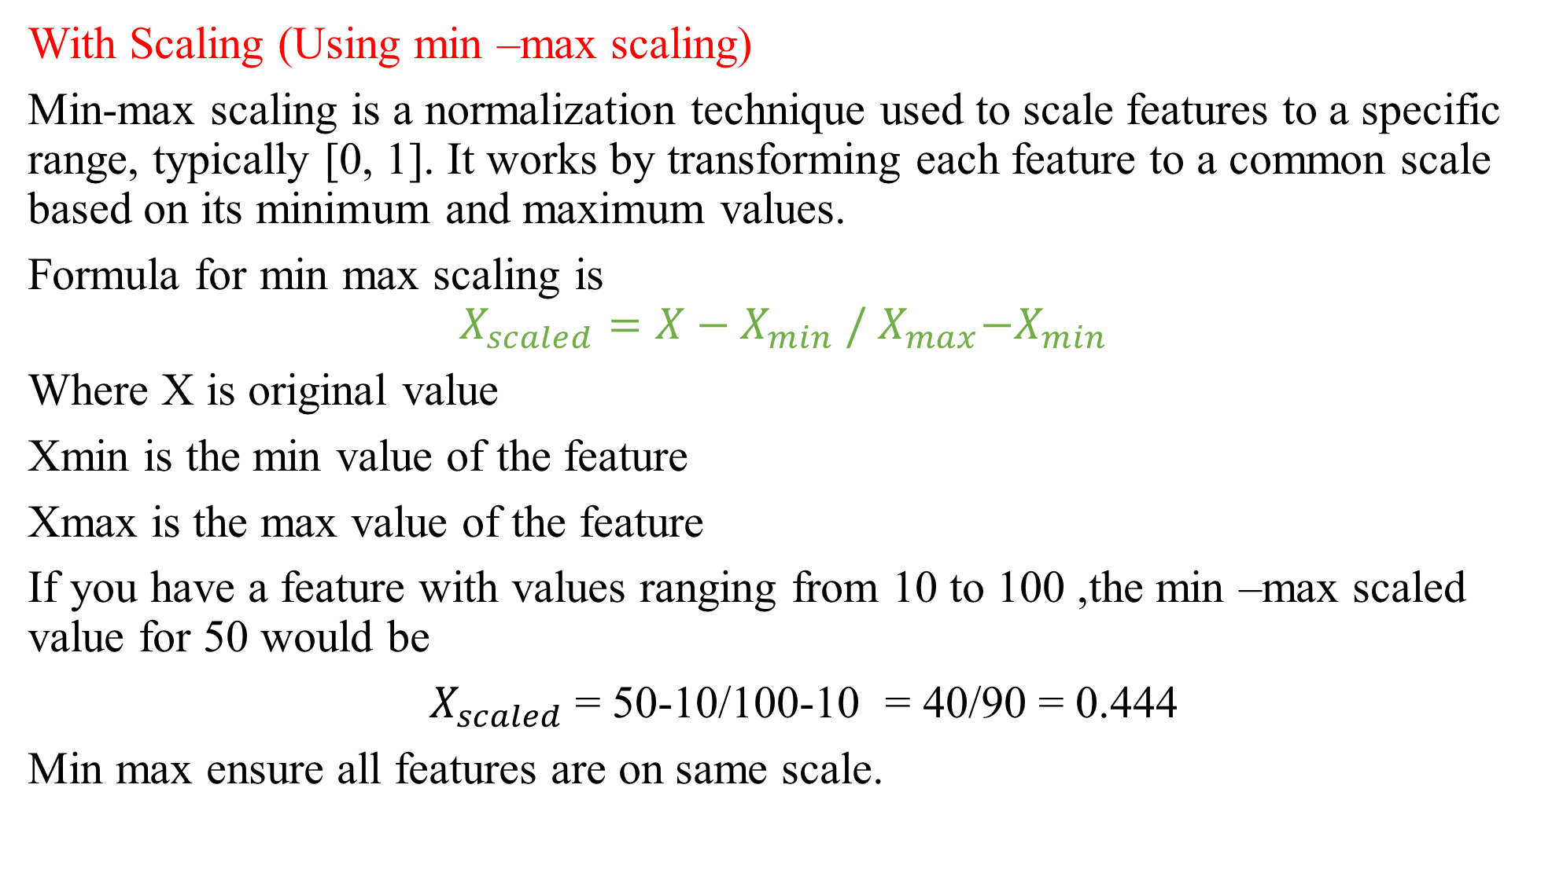
With Scaling (Using min –max scaling)
Min-max scaling is a normalization technique used to scale features to a specific range, typically [0, 1]. It works by transforming each feature to a common scale based on its minimum and maximum values.
Formula for min max scaling is
$$X_{scaled}=X−X_{min} /{ X}_{max}{−X}_{min}$$
Where X is original value
Xmin is the min value of the feature
Xmax is the max value of the feature
If you have a feature with values ranging from 10 to 100 ,the min –max scaled value for 50 would be
${ X}_{scaled}$= 50-10/100-10 = 40/90 = 0.444
Min max ensure all features are on same scale.

Slide 69

With scaling : Age is scaled to a range of [0,1] and scalary is also scaled to [0,1]. After scaling, the values become :
Point A : (Age =0.166,Salary=0.1 )
Point B : (Age =0.3,Salary =0.15)
Distance =√${(0.1667−0.3)}^{2}+{(0.1−0.15)}^{2}$=0.0707
Here both features contribute equally to the distance calculation.
Python declaration :
scaler = StandardScaler()
X_train_scaled = scaler.fit_transform(X_train)
X_test_scaled = scaler.transform(X_test)

Slide 70
Weighted K-Nearest Neighbors (Weighted k-NN) is a variation of the standard k-NN algorithm where the contributions of the neighbors to the final classification or regression prediction are weighted by their distance from the query point. The closer a neighbor is, the more influence it has on the prediction.
Concept:
In the traditional k-NN method, the prediction (for both classification and regression) is based on the majority class or the average of the k-nearest neighbors.
However, in weighted k-NN, each neighbor is assigned a weight based on its distance to the query point. The closer a neighbor is, the higher the weight it receives.
For Classification: The class prediction is based on a weighted vote of the k-nearest neighbors, where closer neighbors have more influence on the final class prediction.
For Regression: The prediction is the weighted average of the k-nearest neighbors' target values, with closer neighbors contributing more to the predicted value.

